Slide 1




THYNK UNLIMITED.
HOME
ABOUT
CONTENT
OTHERS
The Business of
Artificial Intelligence
Next Slide
Artificial Intelligence (AI) is no longer just a futuristic idea—it’s a powerful tool shaping businesses today. From customer service to logistics, AI is driving efficiency, innovation, and new market opportunities across industries.
WHERE INNOVATION MEETS OPPORTUNITY.

Slide 2

THYNK UNLIMITED.
HOME
ABOUT
CONTENT
OTHERS
How AI is Transforming
AI technologies like machine learning, natural language processing, and automation are revolutionizing traditional business models. Companies are using AI to analyze big data, predict trends, personalize services, and streamline internal operations.
Business
Next Slide
CHANGING THE WAY THE WORLD WORKS.

Slide 3

THYNK UNLIMITED.
HOME
ABOUT
CONTENT
OTHERS
Key Industries Benefiting
from Artficial Intelligence
LEADING THE FUTURE, ONE INDUSTRY AT A TIME.
Several sectors are leading the adoption of AI, including healthcare, finance, retail, manufacturing, and transportation. Each industry uses AI in unique ways—from diagnosing diseases to optimizing supply chains—drastically improving results and customer satisfaction.
Next Slide

Slide 4
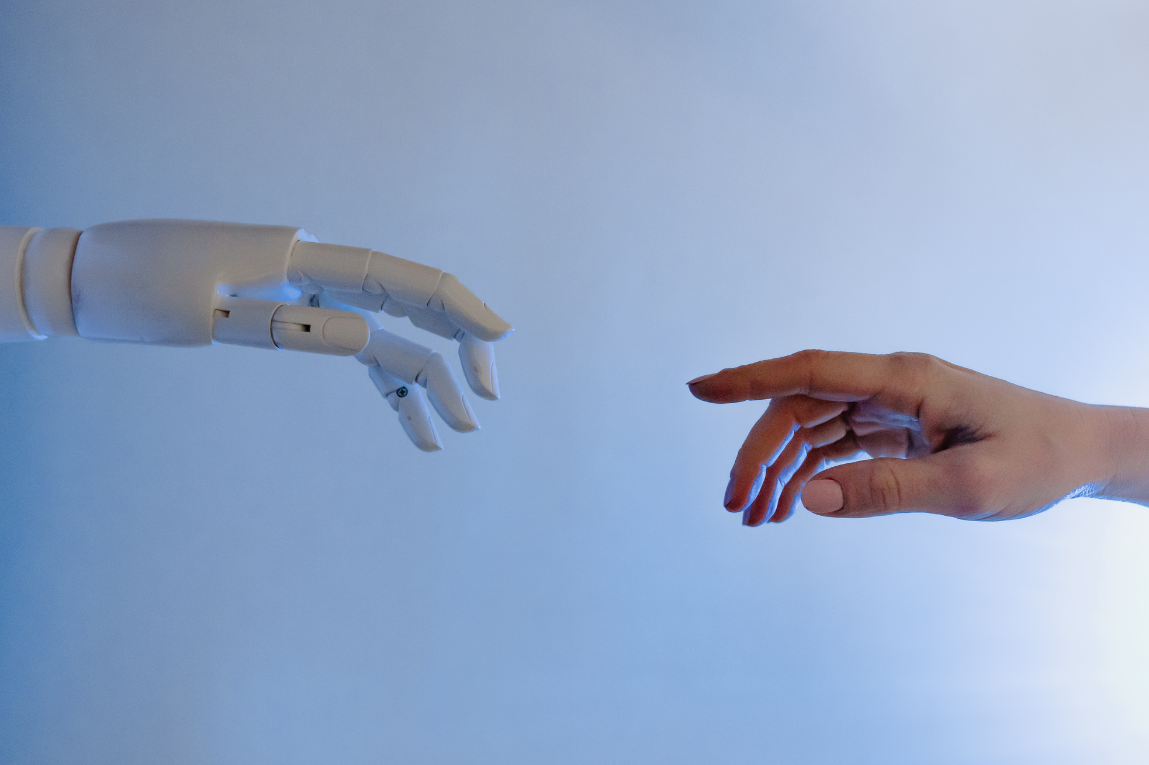
THYNK UNLIMITED.
HOME
ABOUT
CONTENT
OTHERS
AI and Customer
Experiences
PERSONALIZATION POWERED BY INTELLIGENCE.
Businesses are using AI to create more personalized, responsive, and engaging customer experiences. Chatbots, virtual assistants, and recommendation engines are helping brands stay connected to customers 24/7, enhancing loyalty and boosting sales.

Slide 5
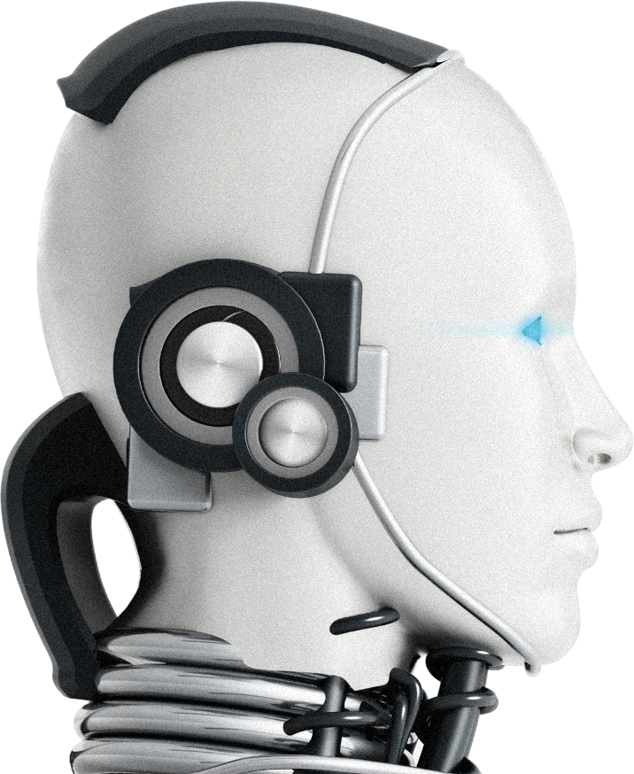
THYNK UNLIMITED.
HOME
ABOUT
CONTENT
OTHERS
Data: The Fuel
AI thrives on data. Companies collect and analyze vast amounts of information to train AI models. Data-driven strategies allow businesses to make smarter decisions, uncover hidden insights, and innovate faster than ever before.
for Artificial Intelligence
Next Slide
DATA DRIVES DECISIONS—AND DESTINY.

Slide 6
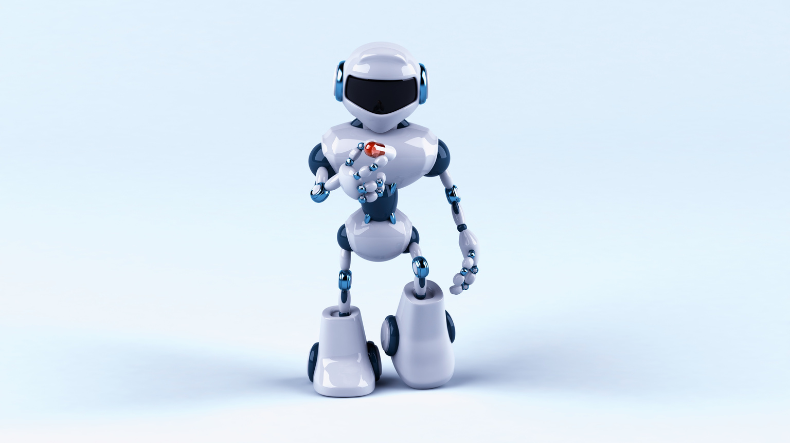
THYNK UNLIMITED.
HOME
ABOUT
CONTENT
OTHERS
Challenges in Implementing
Artificial Intelligence
Businesses are using AI to create more personalized, responsive, and engaging customer experiences. Chatbots, virtual assistants, and recommendation engines are helping brands stay connected to customers 24/7, enhancing loyalty and boosting sales.
Data privacy risks
Bias in algorithms
High costs
WHEN HANDLING SENSITIVE INFORMATION
AFFECTING FAIRNESS AND ACCURACY.
FOR DEVELOPMENT AND INTEGRATION.

Slide 7
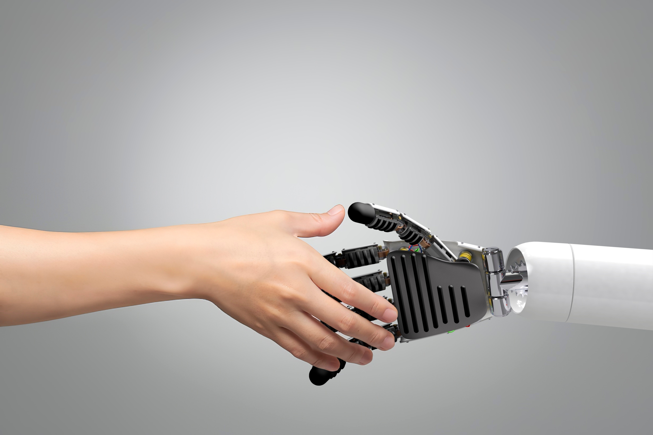
THYNK UNLIMITED.
HOME
ABOUT
CONTENT
OTHERS
AI in Decision-
AI-powered analytics tools are helping executives and managers make faster, more accurate decisions. Predictive modeling and real-time dashboards are becoming essential in identifying market shifts, customer behaviors, and operational bottlenecks.
Making

Slide 8
THYNK UNLIMITED.
HOME
ABOUT
CONTENT
OTHERS
Future Trends in AI
Business Applications
TOMORROW’S BREAKTHROUGHS START TODAY.
The future of AI in business includes hyper-automation, personalized AI agents, AI-driven cybersecurity, and even creative industries powered by generative AI. Companies that stay ahead of these trends will lead the next era of digital transformation.
Next Slide

Slide 9

THYNK UNLIMITED.
HOME
ABOUT
CONTENT
OTHERS
Building a Business
AI Strategy
Next Slide
To succeed with AI, businesses must develop a clear strategy. This includes identifying specific goals, investing in the right talent and tools, ensuring ethical practices, and continuously adapting to technological advances.
PLAN WISELY. EXECUTE SMARTLY.

Slide 10
THYNK UNLIMITED.
HOME
ABOUT
CONTENT
OTHERS
Embracing AI for
Business Growth
Artificial Intelligence is not a distant future—it’s the competitive edge of today. Companies that embrace AI thoughtfully and strategically are setting themselves up for sustainable growth, innovation, and leadership in the market.
Phone:
-
Mail: 000@000.com

